Slide 1

TOPIC
UPDATE
T A S M U N

Slide 2

current events update
UNICEF concluded from their gathered research 25 million child marriages have been prevented in the past decade
Florida changed minimum age for marriage to 17 years old
The Iraqi parliament drafted a law allowing girls from the age of nine to get married
Measures to combat arranged child marriages universally

Slide 3

In 2017, research shows at least 248,000 children were married during 2000 to 2010
The minimum age for marriage in most states is 18, however there are exceptions in each state that provide a loophole to this law.
Depending on the political party there’s a lot of disagreement on child marriage laws. Some believing setting a lower minimum age requirement will reduce the number of single mothers, while other believes people should have the freedom to decide for themselves
How this affects your resolution or stance:
Don’t forget that child marriage is prevalent in both developed and developing countries when trying to write a resolution
USA

Slide 4
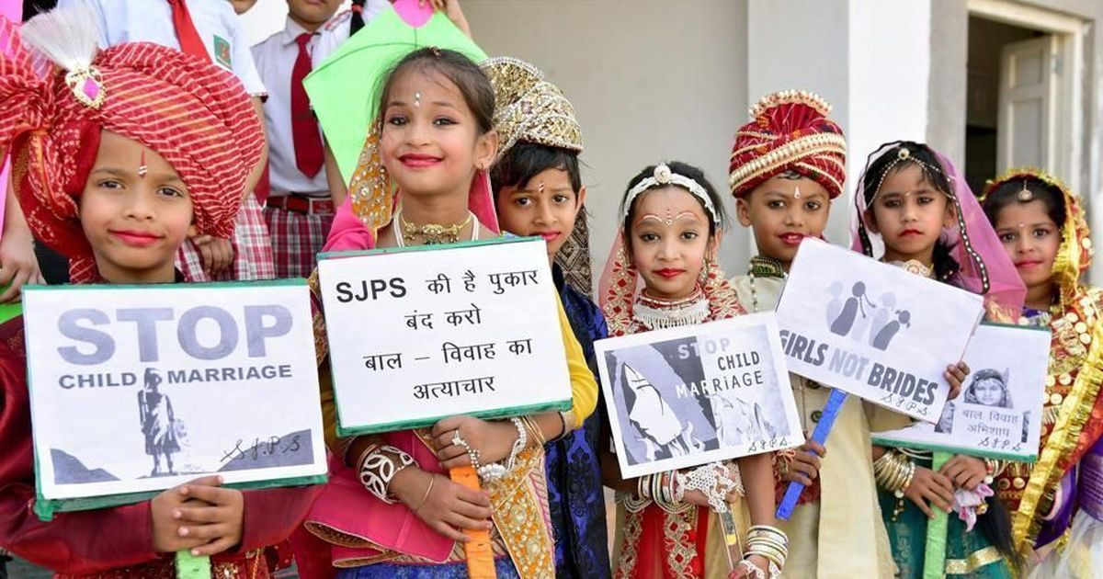
Child Marriage is considered a human rights violation by the United Nations, therefore countries would not directly go against this issue.
How this affects your resolution or stance:
Focus on how to incorporate different actors to work together in combating child marriage. Different actors can include:
Non-Governmental Organizations (ex. Girls not Brides, Save the Children)
Member States
(ex. United States, Ethiopia)
Inter-governmental Organizations
(ex. United Nations, World Bank)
Blocs

Slide 5

Measures to adopt policies, especially fiscal, wage and social protection policies, to improve social welfare systems in order to achieve greater equality
Current Events
On March 13th the EU proposed a European Labour Authority that will assist citizens in finding jobs and an initiative for all workers to be able to receive social protection.
100 million Campaign against child labour launched in Africa (Ghana) and the state is currently discussing policies in need of reform to support the eradication of child labour.
The Organisation for Economic Co-operation and Development: Since 2007 to 2014, 1 in 10 jobs have been destroyed, and the recovery has been weak.
Notes:
http://www.oecd-ilibrary.org/sites/c665889e-en/index.html?contentType=%2fns%2fSummary&itemId=%2fcontent%2fsummary%2fc665889e-en&mimeType=text%2fhtml&containerItemId=%2fcontent%2fserial%2f19991290&accessItemIds=&option6=imprint&value6=http%3a%2f%2foecd.metastore.ingenta.com%2fcontent%2fimprint%2foecd
http://www.ilo.org/wcmsp5/groups/public/---dgreports/---dcomm/---publ/documents/publication/wcms_537846.pdf

Slide 6


Developed Country - USA
North Carolina: Child welfare workers weren’t following laws
Organized structure (Department of Labour)
Developing Country - Bangladesh
Nationally prioritized gender equality
The protection of women and children
Adopted the 2015 National Social Security Strategy
Even though developed countries usually do not need as much enforcement / varying changes needed, this topic is a collective issue located in all places.
Developed & Developing Countries
Notes:
https://www.dol.gov/agencies/ilab/our-work/employment
https://www.taiwannews.com.tw/en/news/3384236
https://reliefweb.int/report/bangladesh/committee-economic-social-and-cultural-rights-reviews-initial-report-bangladesh

Slide 7
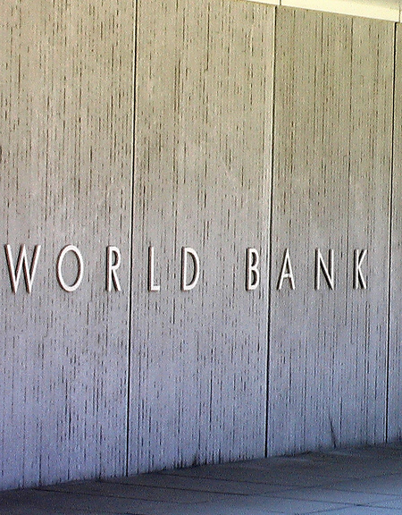
Seeing as topic 2 is a collective issue, there are not any specific countries who should collaborate together. Instead, countries with similar ideas should work together as a bloc.
Issue to Address:
How to reduce the inequality among developed and developing states
Roles of Organizations:
The World Bank & lab “ideas42” encourage cash transfers → social protection
Resolutions should include consideration of multiple perspectives, and work with interdependence.
Blocs
Notes:
https://www.prnewswire.com/news-releases/ideas42-and-the-world-bank-take-crucial-steps-to-strengthen-social-protection-efforts-with-behavioral-design-for-cash-transfer-programs-300609900.html
http://www.europarl.europa.eu/meetdocs/2009_2014/documents/deve/dv/study_social_protecti/study_social_protection.pdf

Slide 8
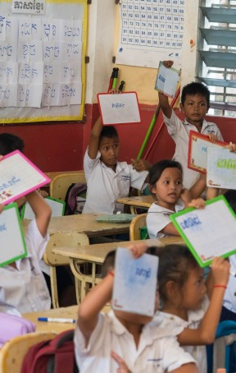
Current Events
4 out of 5 dollars of increase in global wealth in 2017 was received by the top 1%
Signing of Comprehensive and Progressive Trans-Pacific Partnership (CPTPP)
WTO Coalition endorse Buenos Aires Declaration on Trade and Women’s Economic Empowerment
Top 10 multinationals now pay 10% less tax than they did before 2008 financial crisis
Measure to regulate the effects of globalization on drastic livelihood inequalities in regards to living standards, income, education and the like
Notes:
https://www.forbes.com/sites/alexcapri/2018/03/08/trumps-trade-wars-china-inc-s-globalization-plan-and-the-cptpp-whats-next/#570dfbb46479
https://www.ictsd.org/bridges-news/bridges/news/wto-member-coalition-begins-work-to-support-implementation-of-gender
https://www.alternet.org/news-amp-politics/report-discovers-multinational-companies-found-even-more-ways-avoid-taxes

Slide 9
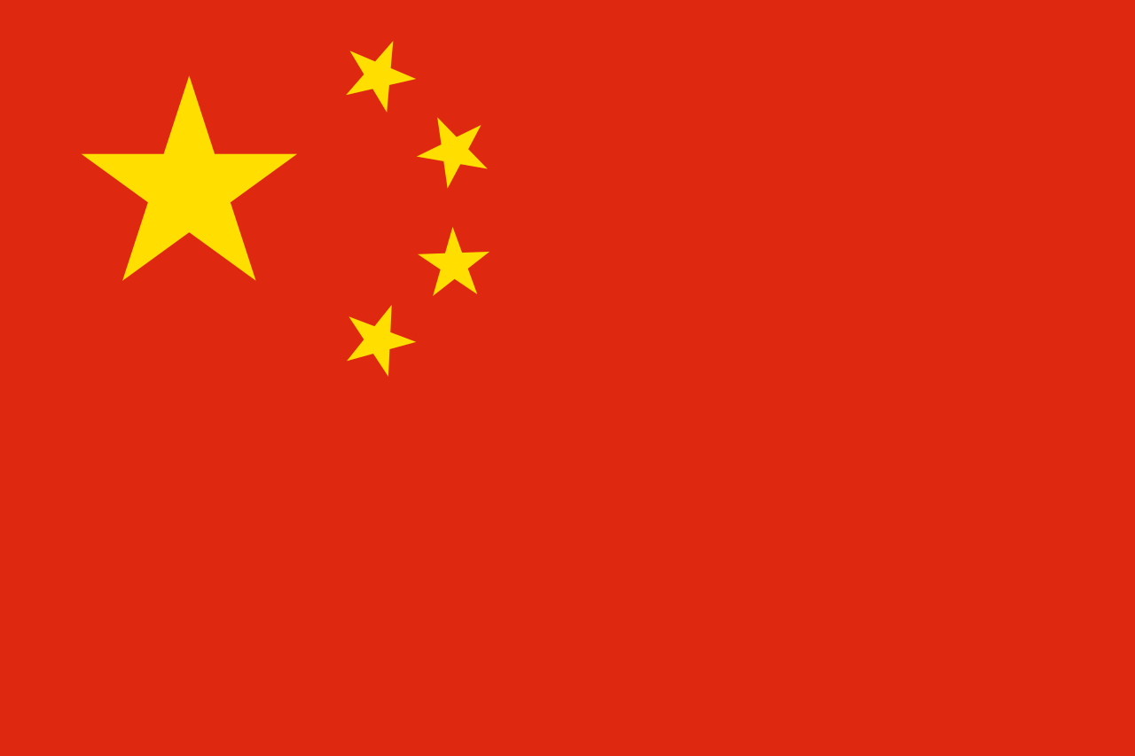
USA: protectionist
Trump: 25% tariff on US imports of steel & 10% on aluminum
Trade wars: working to dismantle US’s free trade agreements
China:
Subsidize Chinese companies
Finalizing new trade agreement: Regional Comprehensive Economic Partnership (RCEP)
USA
& China
Notes:
https://www.forbes.com/sites/alexcapri/2018/03/08/trumps-trade-wars-china-inc-s-globalization-plan-and-the-cptpp-whats-next/#570dfbb46479
https://www.reuters.com/article/us-usa-trade-wto/trumps-tariffs-head-for-a-legal-minefield-idUSKCN1GS1KL
China: assault on fair ocmpeition, can be a targe to future import restrictions?

Slide 10
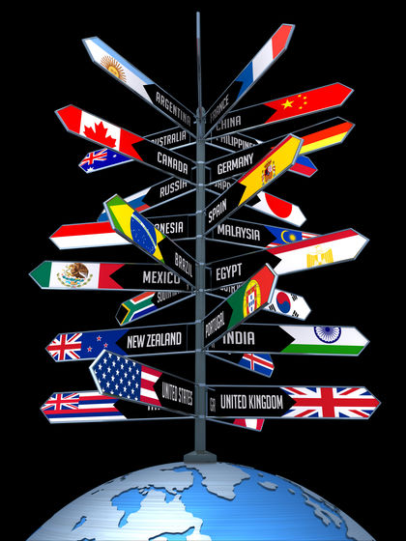
For Fair Trade Model Alliances (ex. CPTPP): trading nations, emerging markets, post-Brexit Britain
Vs.
Unilateralist model: United States, China
Overall Effects:
Job losses
Higher prices
Import restrictions
Gender equality
Blocs
Notes:
https://www.forbes.com/sites/alexcapri/2018/03/08/trumps-trade-wars-china-inc-s-globalization-plan-and-the-cptpp-whats-next/#570dfbb46479
Trump tariff: A crowd of economists and business leaders warned of job losses, damaged industrial competitiveness, and higher costs for businesses and consumers.higher prices, lower sales, and fewer jobs

